Slide 1
Location Based features of the
Oracle RDBMS plus
Some interesting new features of Oracle9i
- Flashback
- Fine Graind Audit
- Workspace Management by
Martin Jensen – martin.jensen@oracle.com for
Danish Database Workshop 15 at AUC
7. – 8. June 2001

Slide 2
Oracle Spatial
Extends the World’s leading information management platform with a native understanding of location
Enables users to manage and analyze geographic data within the Oracle database
Open, standards based data model for universal access
Table
ROAD_ID
1
2
3
NAME
Fisher Cir.
Coop Ct.
85Th St.
SURFACE
Asphalt
Asphalt
Asphalt
LANES
4
2
2
LOCATION

Slide 3
Oracle Spatial
Basic Components:
Example:
X Distance
Hospital #2
First Street
Element 1 (Hole)
Element 0
Hospital #1
Geometry
Type
Main Street
Indexing
SELECT HOSPITAL_NAME FROM HOSPITALS A WHERE SDO_WITHIN_DISTANCE(A.LOCATION, :aGeom, ‘DISTANCE = 10 UNITS=MILES') = 'TRUE';
Analysis

Slide 4
Supported Data Types
Point
Line String
Polygon (with holes)
Circle
Arc Strings
Rectangle
Collections
Building
94102
94103

Slide 5
SDO_GEOMETRY Object
SDO_GEOMETRY Object:
sdo_gtype NUMBER
sdo_srid NUMBER
sdo_point SDO_POINT_TYPE
sdo_elem_info SDO_ELEM_INFO_ARRAY
sdo_ordinates SDO_ORDINATE_ARRAY
Example:
SQL> CREATE TABLE states (
2 state VARCHAR2(30),
3 totpop NUMBER(9),
4 geom MDSYS.SDO_GEOMETRY);

Slide 6
Indexing Techniques
Linear Quadtree (Fixed and Hybrid)
  Quadtree enhanced using b+ tree
  Pros: Fast, tunable, very good on joins, leverages B-tree implementation
  Cons: size
R-trees
  Pros: smaller size, good for selects, popular
  Cons: not tunable, slower on joins, periodic rebuilds may be necessary

Slide 7
Spatial Operators
Full range of spatial operators
  Implemented as functional extensions in SQL
  Topological Operators
    Inside Contains
    Touch Disjoint
    Covers Covered By
    Equal Overlap Boundary
  Distance Operators
    Within Distance
    Nearest Neighbor
INSIDE
X Distance
Hospital #2
First Street
Hospital #1
Main Street

Slide 8
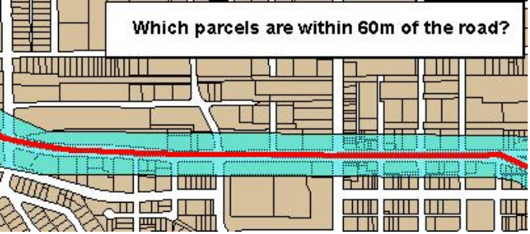
Spatial Functions
Returns a geometry
  Union
  Difference
  Intersect
  XOR
  Buffer
  CenterPoint
  ConvexHull
Returns a number
  LENGTH
  AREA
  Distance
Original
Union
Difference
Intersect
XOR

Slide 9
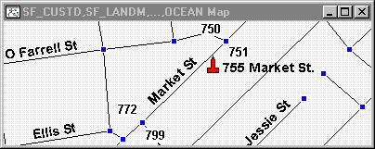
Geocoding
Server based interface to geocoding servers
  Published API in Oracle 8.1.6
Name
Address
ABC
755 Market St.
geocoder_http.geocode1('209.38.36.39/oracle/geoservice.dll', 'my-proxy.us.acme.com', 'user', 'password', 'oracle','1 oracle dr','', 'nashua NH 03062', 'tight', geo_result, geom);

Slide 10
Other 8.1.7 Features
Java Classes (Java API for geometry)
Geocoding API
Coordinate Systems/Projections
  Single geometry or entire table transformations
Versioning
  Available with Database Workspace Manager
R-Tree Indexing (up to 4D)
Linear Referencing Systems (Dyn. Seg.)
GeoImage (Beta)

Slide 11
Oracle Flashback Overview
This feature allows users to see a consistent view of the database at a point in the past
Users can specify this read-only view based on a system time or a system change number (SCN)
Only transactions committed up until that time are visible
Possible applications are:
  Self-service repair
  Packaged applications like email
  Decision support systems for trend analysis

Slide 12
Oracle Flashback
Oracle Flashback leverages the Automatic Undo Management functionality
Undo information is kept for a specified retention interval at system level
Queries addressed to a time within the retention interval have enough undo information to reconstruct the snapshot
Oracle Flashback is enabled at a session level

Slide 13
Flashback Demo

Slide 14
Fine Grained Auditing
A tool to provide extensible intrusion detection, capturing the SQL statement, not the retrieved data
This auditing policy is based on simple user defined SQL predicates on tables as conditions for selective auditing
Attach audit policy to table or view with WHERE condition on SELECT statements
Oracle executes a user-defined audit event handler using autonomous transactions to process the event
A RELAVANT COLUMN feature is provided to reduce false audit conditions

Slide 15
Fine Grained Auditing Implementation
The PL/SQL package DBMS_FGA is provided to administer value-based audit policies
The security administrator uses DBMS_FGA to create an audit policy on the table(s) in question
If any of the rows returned from a query matches the audit condition the database inserts an audit event entry into the audit trail
Administrators can define audit event handlers, to process the event, such as sending an alert page to the administrator.

Slide 16
Fine Grained Auditing Demo

Slide 17
What is Workspace Manager?
Enables web and application based collaboration on database-backed projects
Provides shareable workspaces to version data
Example application:
managing multiple
catalog editions
LIVE Workspace
(Catalog)
Print Edition
Workspace
Web Edition
Workspace
Newspapers
Workspace
Magazines
Workspace

Slide 18
How Does Workspace Manager Work
Automatically installed with Oracle9i
Allows for version-enabling tables by running a packaged procedure
Automatically versions only changed rows
Merges changes with parent
to resolve conflicts
LIV Workspace
(Marketing Budget)
10% Increase
Workspace
25% Increase
Workspace
TV & Web
Workspace
Print & Web
Workspace

Slide 19
Workspace-Enable a Table
DBMS_WM.ENABLEVERSIONING('CATALOG')
UPDATE catalog
SET ...
RENAME…
CATALOG:
base table
CATALOG_LT:
Renamed base table with new columns
CATALOG:
view with instead of triggers

Slide 20
Guidelines for Tables Participating in a Workspace
Version-enabled table must have a primary key
A table can be version-enabled by the table owner or by a user with WM_ADMIN_ROLE
Tables owned by SYS cannot be version-enabled
Referential integrity constraints are supported on version-enabled tables
Triggers are supported on version-enabled tables with some restrictions

Slide 21
Assign Workspace: Associate a User
At login, the user is placed in the LIVE workspace
GOTOWORKSPACE procedure moves the current user session to the destination workspace
To include the user in the E1 workspace:
All subsequent modifications to data by the user take place on the latest versions in the E1
DBMS_WM.GOTOWORKSPACE('E1')

Slide 22
Refresh a Workspace
Applies all changes made in the parent to the child since the child was created or last refreshed
Refresh changes made to a single table:
Refresh all workspace changes:
Before refreshing a table:
Regular (non-workspace) transactions must be committed and conflicts must be resolved
DBMS_WM.RefreshTable('E1','catalogs',
'product_type =''Book''')
DBMS_WM.RefreshWorkspace('E1')

Slide 23
Resolve Workspace Conflicts
Conflict: the same row is changed in two or more workspaces
Conflicts are detected when a workspace merge or refresh operation is attempted
Conflicts must be resolved before merge or refresh operations succeed
Resolve conflicts by choosing a row value from:
  BASE
  CHILD
  PARENT

Slide 24
Conflict Resolution Example:
Check for Existence of Conflicts
Check for conflicts between child and parent:
View Conflicts in table catalog:
DBMS_WM.SetConflictWorkspace('e1_focus_2')
SELECT * FROM catalogs_conf;

Slide 25
Good luck
Martin Jensen
martin.jensen@oracle.com

